Slide 1
Practical Kinetics
Exercise 2:
Integral Rate Laws
Objectives:
Import data from Excel and CSV
Fit to zero-, first-, and second-order rate laws
Error analysis

Slide 2
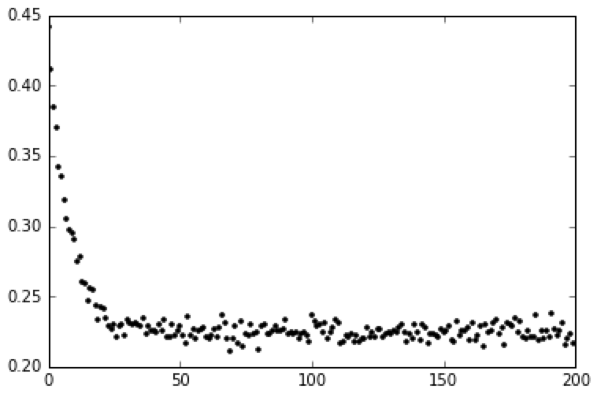
Introduction
In this exercise, we will examine some synthetic absorbance vs. time data:
What is the kinetic order in this reaction?
What are the rate constants? Error bars?
What if other materials absorb at this wavelength?

Slide 3
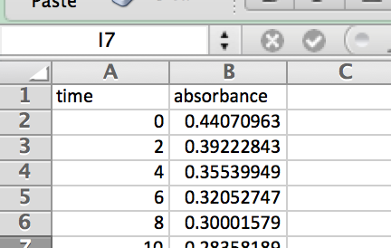
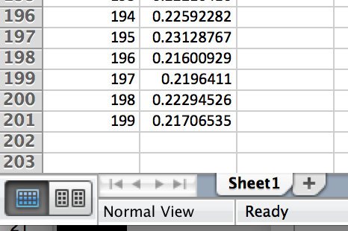
Step 1: Importing Data
Please ensure you have dataset1.xlsx and dataset1.csv in the directory where you start your IPython Notebook.
XLSX is the file extension for Microsoft Excel. Here is what the spreadsheet looks like:
We’ll deal with the simplest case, where there is only one sheet:

Slide 4
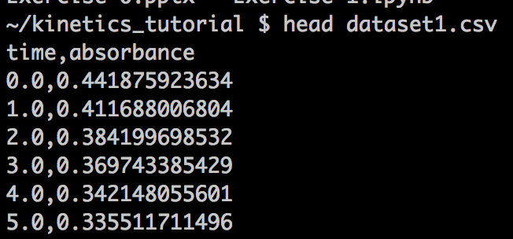
Step 1: Importing Data
CSV stands for comma separated value. This is a common format for instrumental data. You can also save Excel spreadsheets as CSVs.
CSVs are in plain text, so you can use Notepad (PC), Textedit (Mac), or the command line to look at CSVs. As you can see, this is the exact same data:
Let’s convert these files directly into Python lists. You will need some imports:
You’ve seen some of these, but
pandas is the standard Python data
analysis library.
The name derives from “panel data.”
import matplotlib
import matplotlib.pyplot as plt
%matplotlib inline
import numpy as np
from math import exp
import pandas as pd

Slide 5
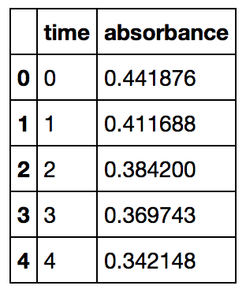
Step 1: Importing Data
Let’s read in the Excel file first:
df = pd.read_excel("dataset1.xlsx")
df.head()
pd represents pandas. df stands for DataFrame, which is the pandas version of a spreadsheet. To put the time and absorbances in lists:
time = df["time"].tolist()
absorbance = df["absorbance"].tolist()
print time[:5]
print absorbance[:5]

Slide 6
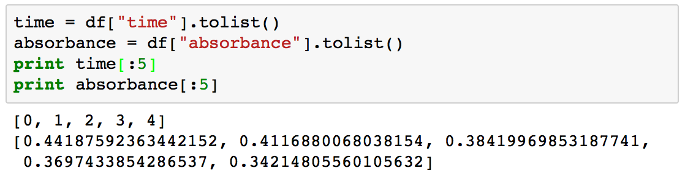
Step 1: Importing Data
In English:
Take the time/absorbance column and make it a list. Print out the first five entries.
There are more sophisticated ways to extract specific columns from specific sheets, but they are beyond the scope of this exercise. Please see:
http://www.gregreda.com/2013/10/26/intro-to-pandas-data-structures/
http://byumcl.bitbucket.org/bootcamp2014/labs/pandas_types.html

Slide 7
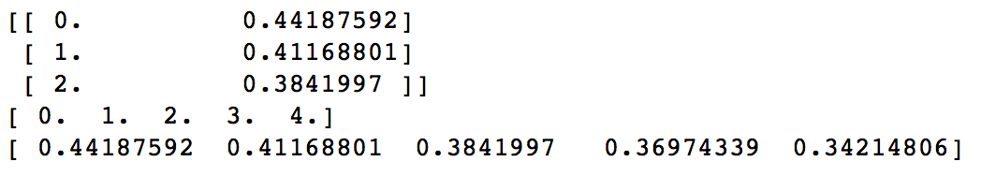
Step 1: Importing Data
To load the CSV data, we can use numpy:
data = np.genfromtxt("dataset1.csv", delimiter=",", skip_header=1)
print data[:3]
time=data[:,0]
absorbance=data[:,1]
print time[:5]
print absorbance[:5]
The output is:
In English:
Load CSV data from dataset1.csv, where the columns are separated by commas, and ignore the first row. Print out the first three entries.
As you can see, the data get loaded in “tuple” form, so we use [:,0] to transpose the data into column vectors. We then print out the first five elements.

Slide 8
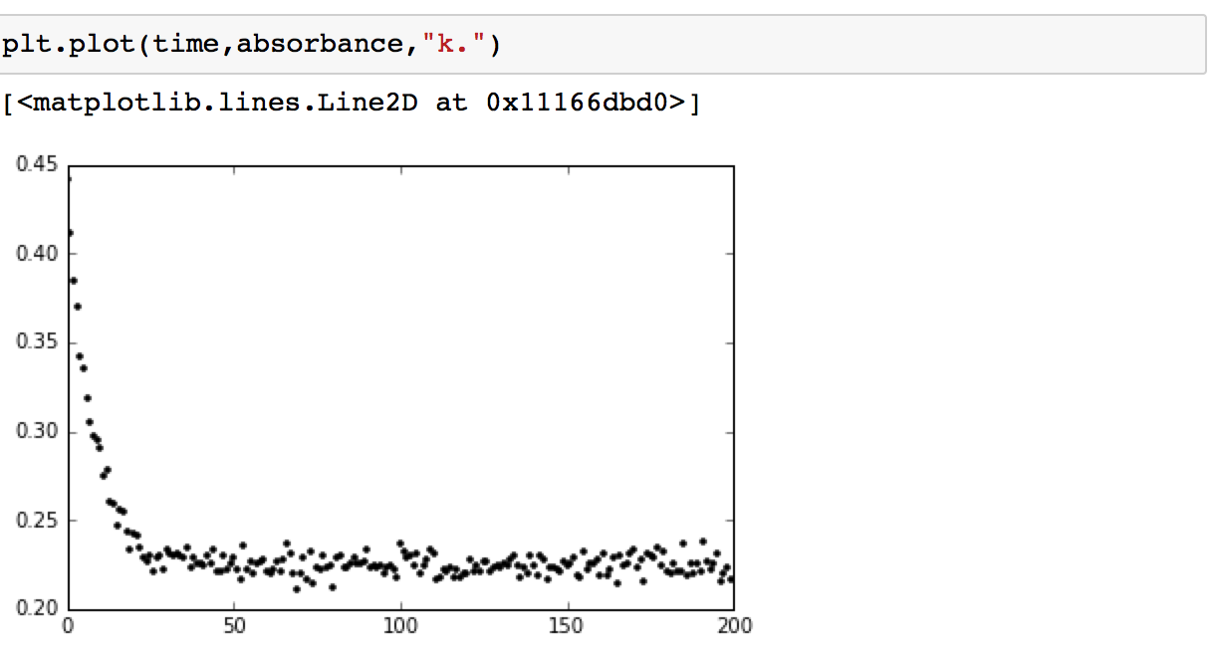
Step 2: A First Look
Let’s take a look at the data:
What is the kinetic order?

Slide 9
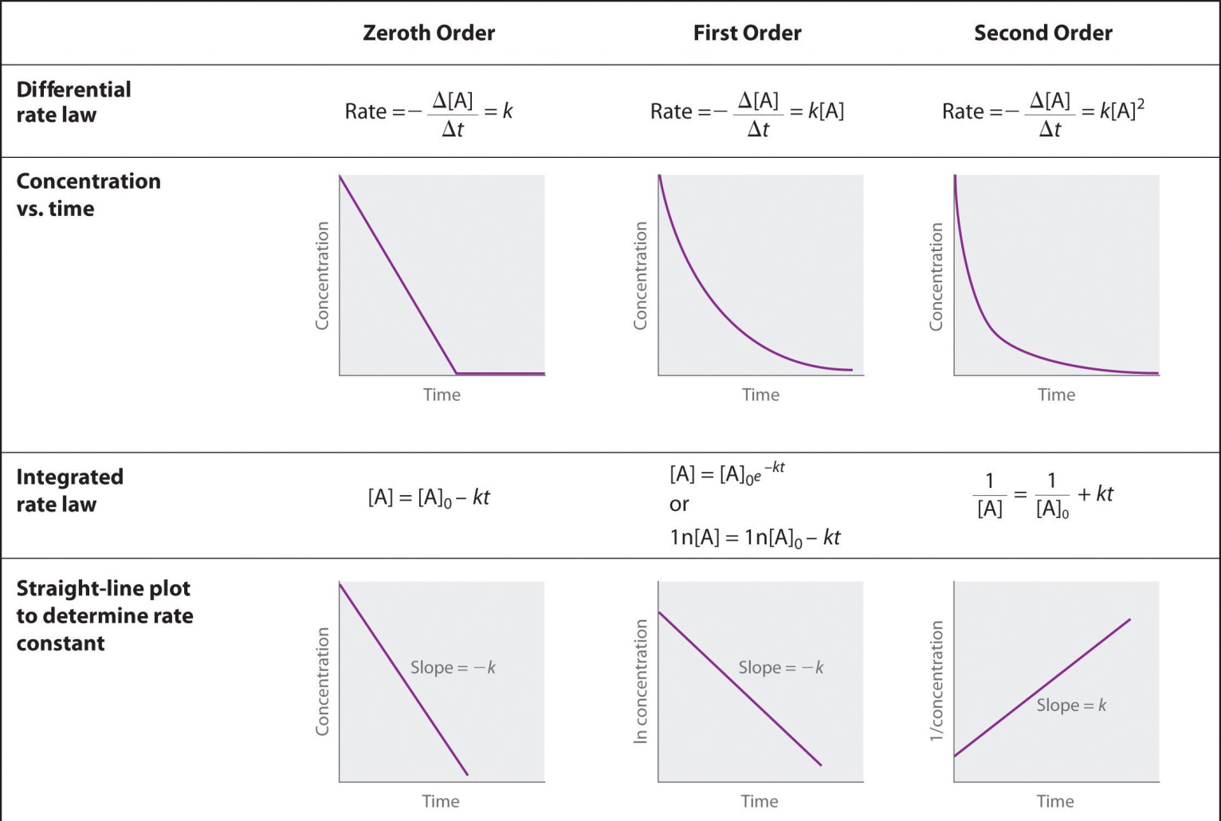
Step 2: A First Look
As a reminder:

Slide 10
Step 2: A First Look
Plot the linearized forms of the zero-, first-, and second-order integral rate laws:
corrected_absorbance = absorbance - np.min(absorbance)
log_absorbance = np.log(corrected_absorbance)
one_over_time = 1.0/time
one_over_absorbance = 1.0/absorbance
plt.plot(time[:30],absorbance[:30],"k.")
plt.show()
plt.plot(time[:30],log_absorbance[:30],"r.")
plt.show()
plt.plot(one_over_time[:30],one_over_absorbance[:30],"b.")
plt.show()
np.min finds the minimum of a list. If we don’t do this, then we will get some negative numbers when we take the natural log with np.log.
Since most of the run was noise, I’m only showing the first thirty points. In reality, it would not be a good idea to collect data past five half-lives.
For now, let’s ignore the fact that absorbance is not equal to concentration.

Slide 11
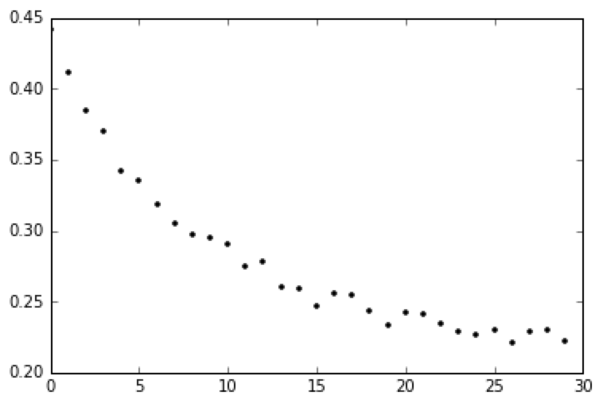
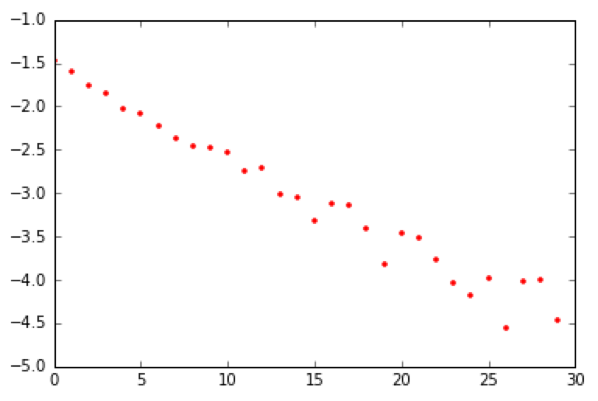
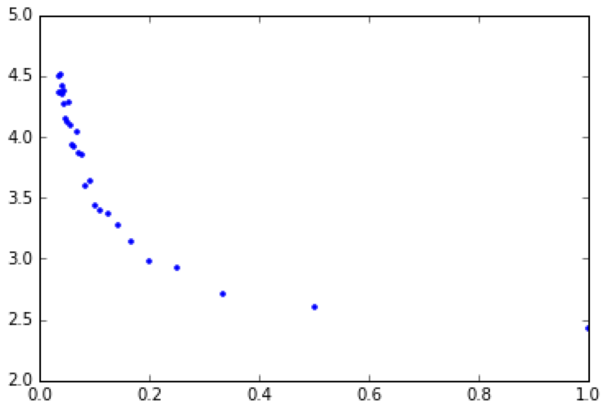
Step 2: A First Look
Plot the linearized forms of the zero-, first-, and second-order integral rate laws:
(In your browser, these will appear one after another instead of side by side.)
Clearly, the first-order fit is best. If we call the starting material “A,” then:
If the system obeys Beer’s law for the experimental concentration (c) range, then:
where I combined the path length (b) and the extinction coefficient (ε) into ε’.

Slide 12
Step 3: First-Order Fit
Previously (lectures 1 and 2), we showed that when other species also absorb, we pick up a constant c. (This could also account for any background absorbance, like that of the container.)
Therefore:
where c₁ represents the infinity value, c₂ is ε’, and k is the rate constant.
As you can see, we don’t need to know the extinction coefficient to determine k.
Now, let’s fit the data to this three-parameter function. As in Exercise 1, we’ll use scipy.optimize.curve_fit, a least squares tool.

Slide 13
Step 3: First-Order Fit
from scipy.optimize import curve_fit
def first_order_function(t, pre_factor, rate_constant, offset):
return pre_factor*np.exp(-rate_constant*t) + offset
popt, pcov = curve_fit(first_order_function, time, absorbance)
errors = np.sqrt(np.diag(pcov))
print "pre_factor: %7.4f ± %6.4f" % (popt[0], errors[0])
print "rate_const: %7.4f ± %6.4f" % (popt[1], errors[1])
print "offset: %7.4f ± %6.4f" % (popt[2], errors[2])
fitted_absorbance = [ first_order_function(t, popt[0], popt[1], popt[2]) for t in time ]
plt.plot(time,absorbance,"k+")
plt.plot(time,fitted_absorbance,"k")
We use np.sqrt(np.diag(pcov)) to extract the uncertainties in the optimized parameters (popt).
This form of the print statement allows us to specify the number of decimal places to print out. %7.4f means: “Print out this floating point number with seven characters, using 4 decimal places.” The arguments after the final % are read in order: the first %7.4f refers popt[0], the second %6.4f refers to errors[0].

Slide 14
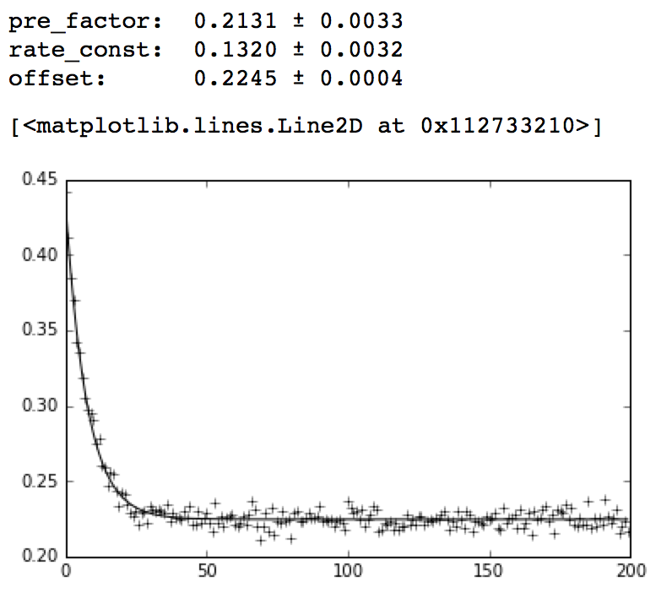
Step 3: First-Order Fit
Visually, this looks like a good fit. But just how good is it actually?
We should look at the residuals, the difference between the observed and predicted values.

Slide 15
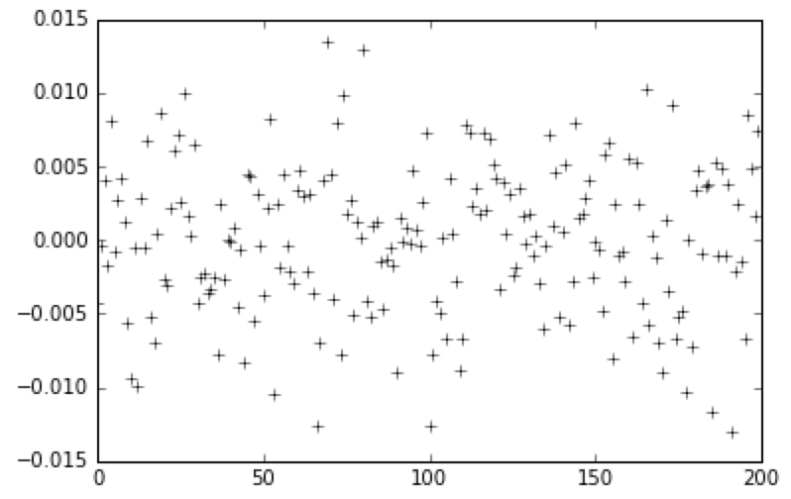
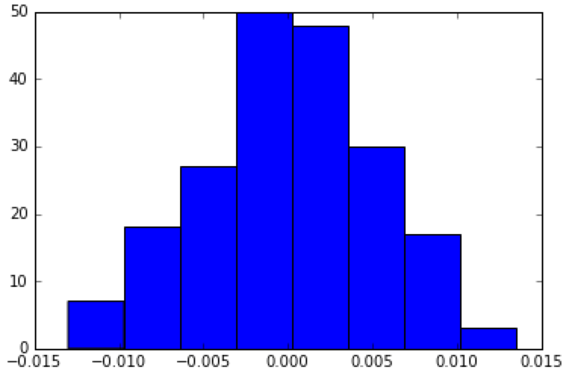
Step 4: Plot the Residuals
residual = fitted_absorbance - absorbance
plt.plot(time, residual, "k+")
plt.show()
plt.hist(residual,bins=8)
plt.show()
standard_deviation = np.std(residual)
print "standard deviation: %5.2E" % standard_deviation
The residuals are normally distributed, which is a sign of a good fit.
We made a histogram with plt.hist. We also printed out the standard deviation in scientific notation (%5.2E). We will need this value in a moment.

Slide 16
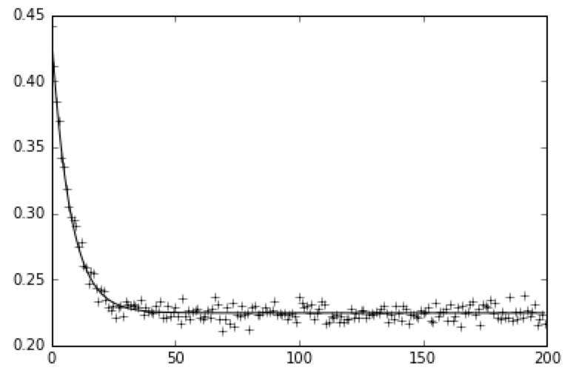
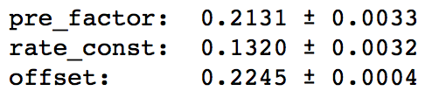
Step 5: Fit with Error Bars
Here is our fit again:
Notice that the latter part of the experiment is all noise. It doesn’t make sense to fit each point with equal weight! As a result, the error bars in the parameters we got are meaningless:

Slide 17
Step 5: Fit with Error Bars
Let’s fit again, but weight each point by the signal to noise ratio:
weights = [ (i/standard_deviation)**2 for i in absorbance ]
popt, pcov = curve_fit(first_order_function, time, absorbance, sigma=weights)
errors = np.sqrt(np.diag(pcov))
print "pre_factor: %7.4f ± %6.4f" % (popt[0], errors[0])
print "rate_const: %7.4f ± %6.4f" % (popt[1], errors[1])
print "offset: %7.4f ± %6.4f" % (popt[2], errors[2])
fitted_absorbance2 = [ first_order_function(t, popt[0], popt[1], popt[2]) for t in time ]
plt.plot(time,absorbance,"k+")
plt.plot(time,fitted_absorbance2,"k")
This kind of square weighting is standard.
Note that the result is now going into fitted_absorbance_2.

Slide 18
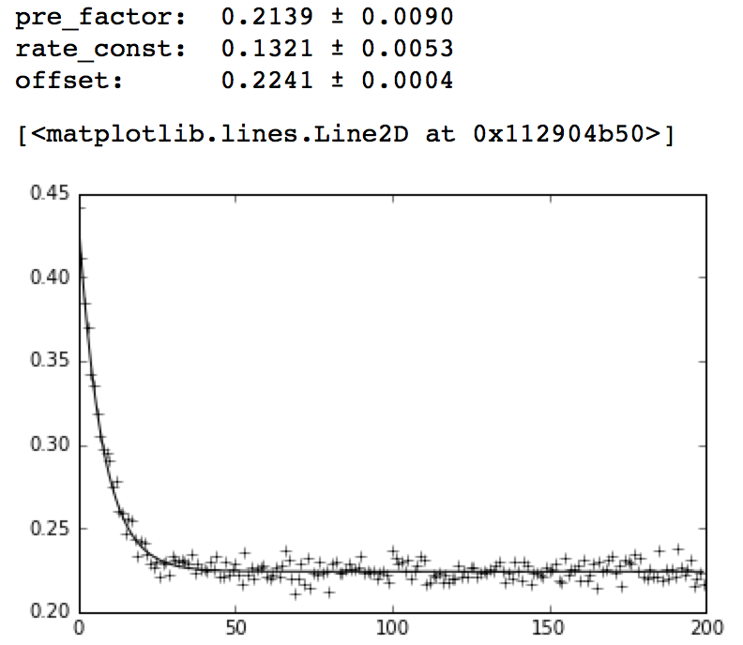
Step 5: Fit with Error Bars
The fit has changed slightly, but the error bars are now meaningful:
(old)

Slide 19
Step 6: Chi-Square
A more accurate indication of the goodness-of-fit is the chi-square statistic:
Just as the normal distribution describes the sampling distribution of the mean, the chi-square distribution describes the sampling distribution of the variance.
In our case, we have a series of normally distributed random variables with means μ_{i} and standard deviations σ_{i}, chi-square is defined as:
Since the fluctuation about each mean is on the order of σ, we expect this to sum to about the number of data points.

Slide 20
Step 6: Chi-Square
We can then employ the following test procedure:
Calculate chi-square.
Calculate the degrees of freedom as the number of data points minus the number of model parameters.
Divide chi-square by the number of degrees of freedom to get the “goodness of fit” or “normalized chi-square.”
The expected value of this statistic is 1.0, such that:
goodness of fit >> 1: poor fit
goodness of fit = 1: good fit
goodness of fit << 1: error bars are underestimated
For a more detailed analysis: http://maxwell.ucsc.edu/~drip/133/ch4.pdf
For another Python implementation: http://www.physics.utoronto.ca/~phy326/python/ (curve fit to data)

Slide 21
Step 6: Chi-Square
In Python:
dof = len(time)-3
def chi_square(observed, expected, stdev):
chi_squared_value = 0.0
for i in range(len(observed)):
o = observed[i]
e = expected[i]
chi_squared_value += ((o-e) / standard_deviation)**2
return chi_squared_value
goodness_of_fit = chi_square(absorbance,fitted_absorbance2,standard_deviation) / dof
print "chi_squared / dof = %.4f" % goodness_of_fit
We find a good fit:

Slide 22
Step 7: Zeroth-Order Fit
For a zeroth-order process:
In the last step, I collapsed the first and third terms into one constant.
Again, we can determine what the rate constant is without knowing what the extinction coefficient is.

Slide 23
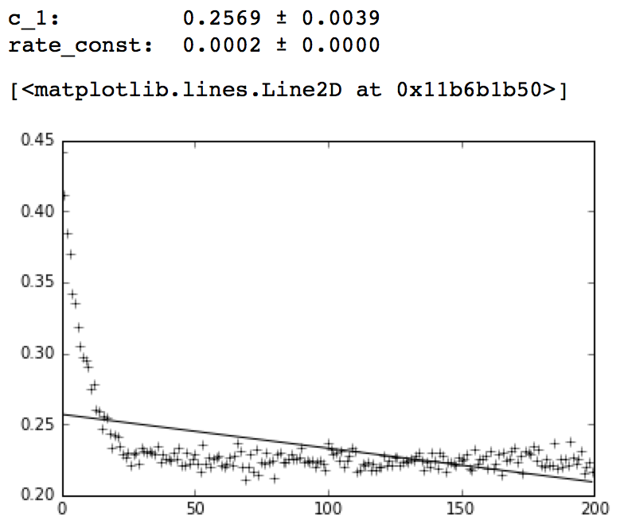
Step 7: Zeroth-Order Fit
def zero_order_function(t, c_1, rate_constant):
return c_1 - rate_constant*t
popt, pcov = curve_fit(zero_order_function, time, absorbance)
errors = np.sqrt(np.diag(pcov))
print "c_1: %7.4f ± %6.4f" % (popt[0], errors[0])
print "rate_const: %7.4f ± %6.4f" % (popt[1], errors[1])
fitted_absorbance3 = [ zero_order_function(t, popt[0], popt[1]) for t in time ]
plt.plot(time,absorbance,"k+")
plt.plot(time,fitted_absorbance3,"k")
We defined a new function,
zero_order_function,
to represent the zeroth order rate law.
The fit is terrible.
For the chi-square analysis, we need
to adjust the degrees of freedom
for this 2-parameter fit.

Slide 24
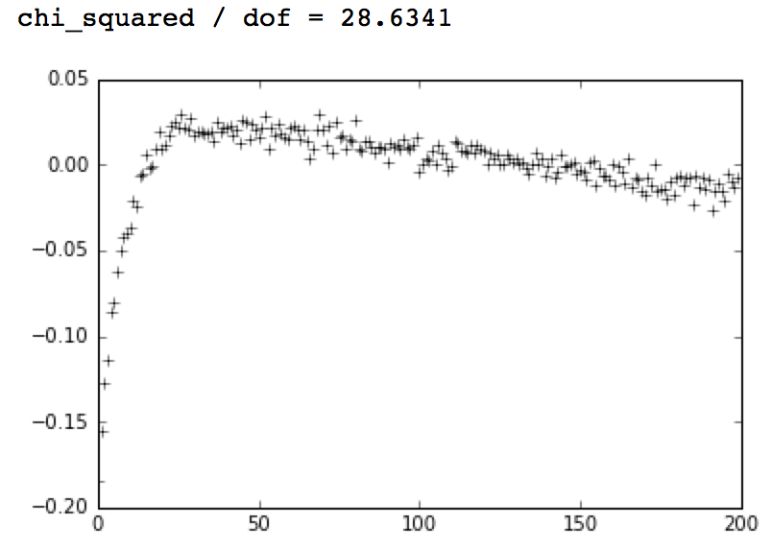
Step 7: Zeroth-Order Fit
The goodness of fit is bad as well:
dof = len(time) - 2
residual3 = fitted_absorbance3 - absorbance
plt.plot(time,residual3,"k+")
goodness_of_fit = chi_square(absorbance,fitted_absorbance3,standard_deviation) / dof
print "chi_squared / dof = %.4f" % goodness_of_fit
Curved residuals are a strong visual indicator of a poor fit.

Slide 25
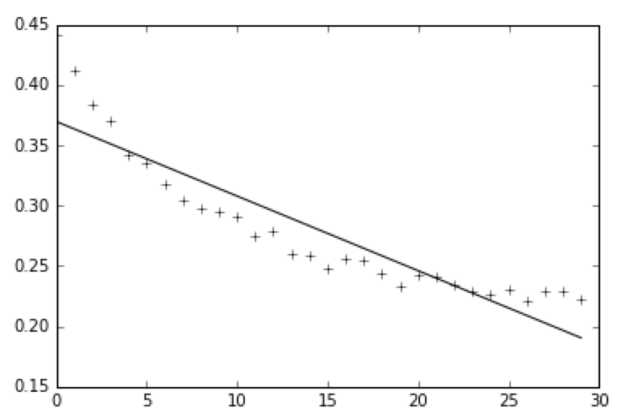
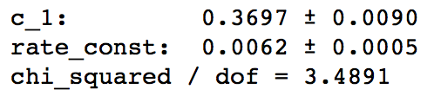
Step 7: Zeroth-Order Fit
The fit is artifically bad because we fitted a lot of points at very high conversions:
popt, pcov = curve_fit(zero_order_function, time[:30], absorbance[:30])
errors = np.sqrt(np.diag(pcov))
print "c_1: %7.4f ± %6.4f" % (popt[0], errors[0])
print "rate_const: %7.4f ± %6.4f" % (popt[1], errors[1])
fitted_absorbance3 = [ zero_order_function(t, popt[0], popt[1]) for t in time[:30] ]
goodness_of_fit = chi_square(absorbance[:30],fitted_absorbance3,standard_deviation) / dof
print "chi_squared / dof = %.4f" % goodness_of_fit
plt.plot(time[:30],absorbance[:30],"k+")
plt.plot(time[:30],fitted_absorbance3[:30],"k")
This uses [:30] to deal with the first
thirty points only.

Slide 26
Step 8: Second-Order Fit
For a second-order reaction:
This is a three parameter fit. We cannot determine what the rate constant is unless we know what the initial concentration is because c₂ contains both k and [A]₀.

Slide 27
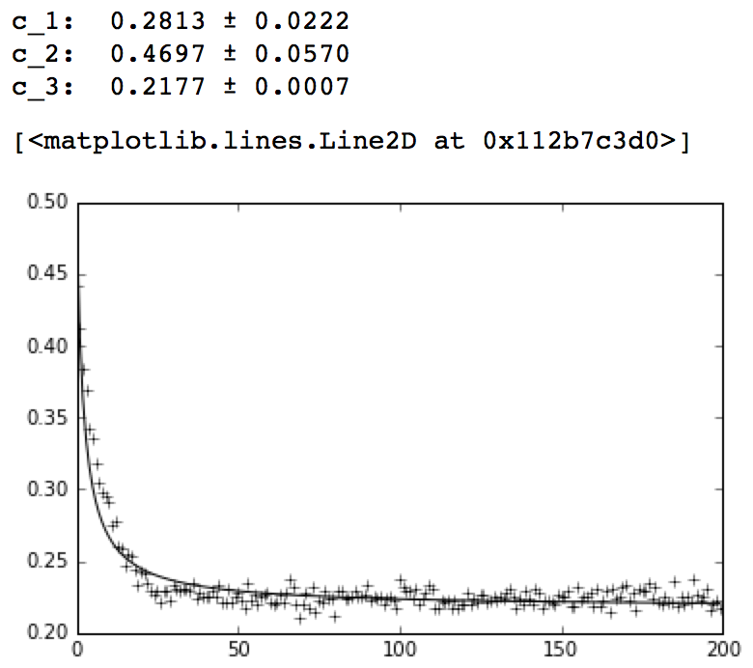
Step 8: Second-Order Fit
def second_order_function(t, c_1, c_2, c_3):
return (c_1 / ( 1.0 + c_2*t )) + c_3
popt, pcov = curve_fit(second_order_function, time, absorbance,sigma=weights)
errors = np.sqrt(np.diag(pcov))
print "c_1: %7.4f ± %6.4f" % (popt[0], errors[0])
print "c_2: %7.4f ± %6.4f" % (popt[1], errors[1])
print "c_3: %7.4f ± %6.4f" % (popt[2], errors[2])
fitted_absorbance4 = [ second_order_function(t, popt[0], popt[1], popt[2]) for t in time ]
plt.plot(time,absorbance,"k+")
plt.plot(time,fitted_absorbance4,"k")
This fit actually looks decent! Qualitatively,
first- and second-order reactions are
very similar, but second-order reactions
are more senstitive to concentration.
Let’s look at the residuals and
goodness of fit.

Slide 28
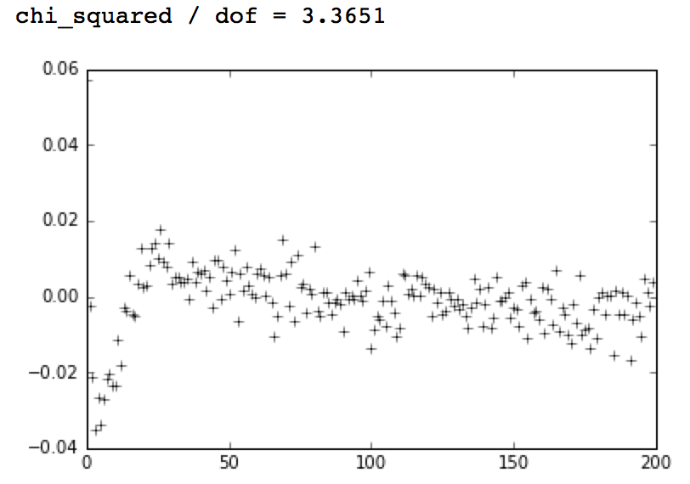
Step 8: Second-Order Fit
dof = len(time) - 3
residuals4 = fitted_absorbance4 - absorbance
plt.plot(time,residuals4,"k+")
goodness_of_fit = chi_square(absorbance,fitted_absorbance4,standard_deviation) / dof
print "chi_squared / dof = %.4f" % goodness_of_fit
Again, the residuals are strongly curved. The goodness of fit is significantly different from 1.0.

Slide 29
Summary
Useful imports for fitting:
import matplotlib
import matplotlib.pyplot as plt
%matplotlib inline
import numpy as np
from math import exp
import pandas as pd
from scipy.optimize import curve_fit
To import data from Excel:
import pandas as pd
df = pd.read_excel("dataset1.xlsx")
df.head()
time = df["time"].tolist()
absorbance = df["absorbance"].tolist()
print time[:5]
print absorbance[:5]

Slide 30
Summary
To import data from CSV:
import numpy as np
data = np.genfromtxt("dataset1.csv", delimiter=",", skip_header=1)
print data[:3]
time=data[:,0]
absorbance=data[:,1]
print time[:5]
print absorbance[:5]
This requires the numpy library. List slicing (i.e., the notation in the square brackets) is needed to rearrange the data into vector form.
To analyze absorbance data:
The system should obey Beer’s Law over the experimental concentration range.
The observed absorbance at a given wavelength can reflect the absorbances of species other than the one of interest, including that of background.
One can convert the absorbance data to concentration data before analysis using a standard curve. For zeroth- and first-order reactions, this is not necessary.

Slide 31
Sample Code
This code demonstrates the concepts described above in one place.
It does not depend on any of the code we just wrote. You can simply paste it into a new notebook and run it.
import matplotlib
import matplotlib.pyplot as plt
%matplotlib inline
import numpy as np
from math import exp
import pandas as pd
from scipy.optimize import curve_fit
data = np.genfromtxt("dataset1.csv", delimiter=",", skip_header=1)
time=data[:,0]
absorbance=data[:,1]
def first_order_function(t, pre_factor, rate_constant, offset):
return pre_factor*np.exp(-rate_constant*t) + offset
popt, pcov = curve_fit(first_order_function, time, absorbance)
fitted_absorbance = [ first_order_function(t, popt[0], popt[1], popt[2]) for t in time ]
residual = fitted_absorbance - absorbance
standard_deviation = np.std(residual)
weights = [ (i/standard_deviation)**2 for i in absorbance ]

Slide 32
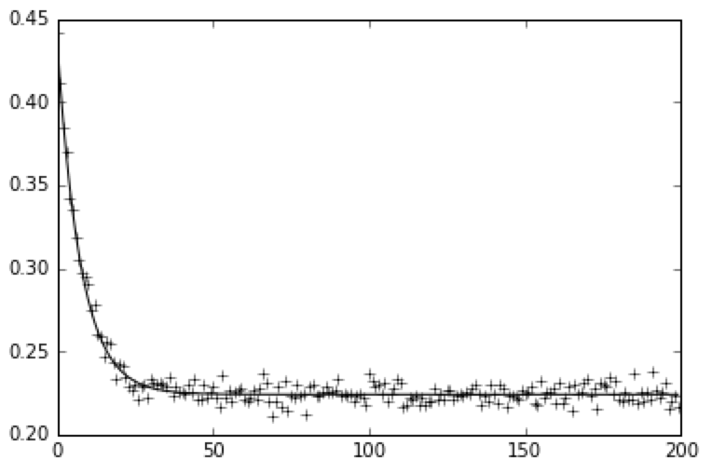
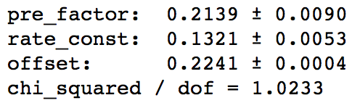
Sample Code
(continued)
popt, pcov = curve_fit(first_order_function, time, absorbance, sigma=weights)
errors = np.sqrt(np.diag(pcov))
print "pre_factor: %7.4f ± %6.4f" % (popt[0], errors[0])
print "rate_const: %7.4f ± %6.4f" % (popt[1], errors[1])
print "offset: %7.4f ± %6.4f" % (popt[2], errors[2])
fitted_absorbance = [ first_order_function(t, popt[0], popt[1], popt[2]) for t in time ]
dof = len(time)-3
def chi_square(observed, expected, stdev):
chi_squared_value = 0.0
for i in range(len(observed)):
o = observed[i]
e = expected[i]
chi_squared_value += ((o-e) / standard_deviation)**2
return chi_squared_value
goodness_of_fit = chi_square(absorbance,fitted_absorbance,standard_deviation) / dof
print "chi_squared / dof = %.4f" % goodness_of_fit
plt.plot(time,absorbance,"k+")
plt.plot(time,fitted_absorbance,"k")

